Slide 2
Digital technology
TK1104-1 22H
Lecturer: Toktam Ramezanifarkhani
Toktam.Ramezanifarkhani@kristiania.no
Toktamr@ifi.uio.no

Slide 3
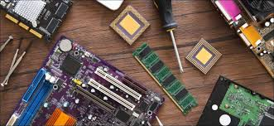
Hardware-Computer Organization

Slide 4
So far
Generally
First Abstraction level, computer defintion
Digital vs analog, Harware, Software
Computation in computer
Binary system
Computer Arch.
Gates, digtal circutes
TYPES: Analog vs. Digital, Continuous vs. Discrete, Specialized vs. General, Electronic vs. Mechanical
https://www.youtube.com/watch?v=btgAUdbj85E&t=10s
https://www.youtube.com/watch?v=L_j8wlm2NKA

Slide 5

Today
Instructions and programming based on CPU
Structure, Register, IPOS
Construction of (IBM) PC systems.
Not the only ones, previous lecture.
Not looking at EVERYTHING.
Hopefully some of the most important
Most important
Understand context
Not all components in detail,
but what type they are &
How they relate to the rest

Slide 6
The motherboard

Slide 7
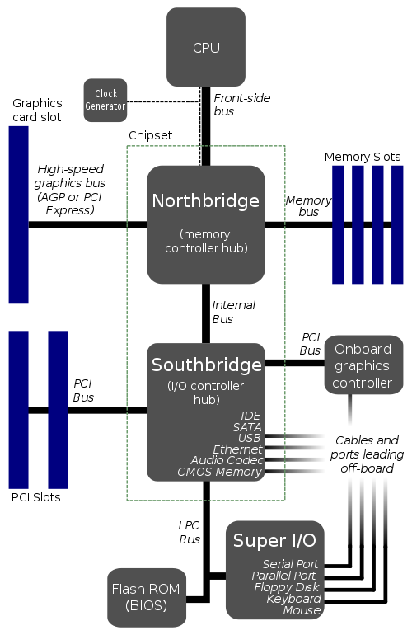
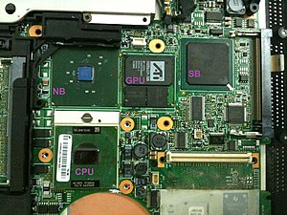
Motherboard
a set of electronic components in an integrated circuit known as a "Data Flow Management System" that manages the data flow between the processor, memory and peripherals
Connects:
CPU
Chipset
Buses
Memory tracks and RAM
Expansion slots and extra cards
Gates and «plugs»
Notes:
the term chipset commonly refers to a set of specialized chips on a computer's motherboard
https://www.tomshardware.com/reviews/motherboard-parts-explained,5669.html

Slide 8
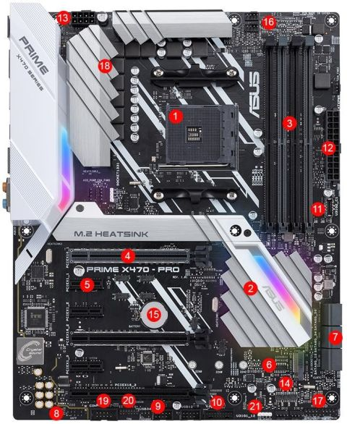
Modern Motherboard: Connectors, Ports & Chipsets
Asus Prime X470-Pro
DIMM (dual in-line memory module) slots are the place on your motherboard where the RAM goes
1. CPU socket | 2. Chipset | 3. DIMM/RAM slots
4. PCIe x16 slot | 5. PCI x1 slot | 6. M.2 connector
7. SATA ports | 8. Front panel connectors | 9. USB 2. header
10. USB 3.1 Gen1 header | 11. USB 3.1 Gen2 header | 12. ATX power connector
13. CPU power connector | 14. BIOS chips | 15. CMOS battery
16. Fan headers | 17. Front panel header | 18. VRM heatsink
19. COM/Serial header | 20. TPM header | 21. RGB header
A PCIe x1 slot has one lane and can move one bit per cycle
X16 ideal for large and power hungry cards like a graphics card
To connect hard drives to motherboards
a ROM chip found on motherboards that allows you to access and set up your computer system at the most basic level
The BIOS is the program that starts a computer up, and the CMOS is where the BIOS stores the date, time, and system configuration details it needs to start the computer. ... CMOS is a type of memory technology, but most people use the term to refer to the chip that stores variable data for startup.
Voltage Regulator Thermal Module Pad
Notes:
https://www.tomshardware.com/reviews/motherboard-parts-explained,5669.html
CMOS stands for “Complementary Metal Oxide Semiconductor.” The CMOS battery powers the BIOS firmware in your laptop [2]. BIOS needs to remain operational even when your computer isn't plugged into a power source. ... When your computer gets unplugged, BIOS relies on the CMOS battery for power.
COM (communication port) is the original, yet still common, name of the serial port interface on PC-compatible computers. It can refer not only to physical ports, but also to emulated ports, such as ports created by Bluetooth or USB adapters.

Slide 9
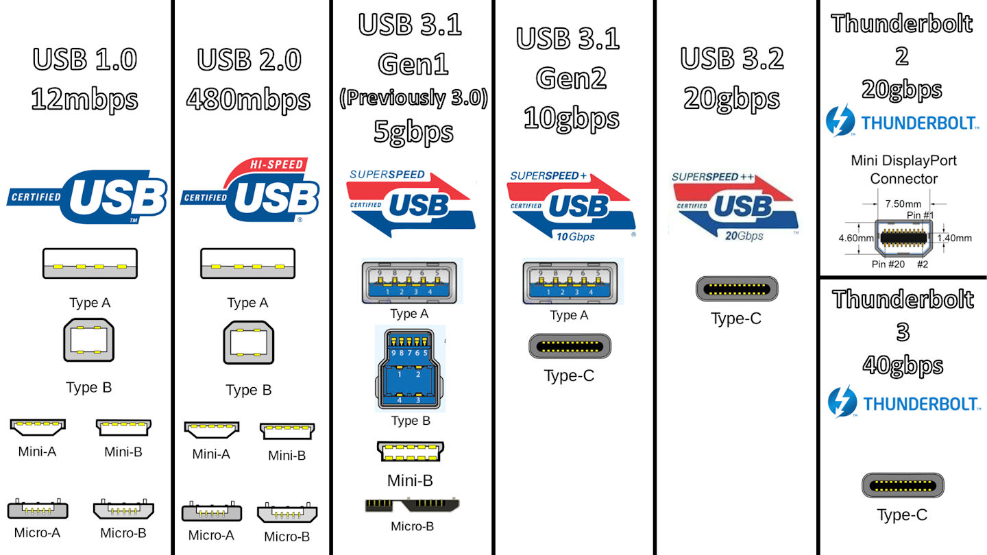
Different USBs
https://www.youtube.com/watch?v=dERa_bMDvcg

Slide 10
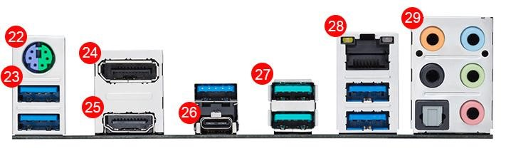
Rear Ports
High-Definition Multimedia Interface (HDMI) is an audio/video interface for transmitting uncompressed video data and compressed or uncompressed digital audio data from an HDMI-compliant source device, such as a display controller, to a compatible computer monitor, video projector, digital television, or digital audio device.
22. PS/2 Keyboard/Mouse port | 23. USB 3.0/3.1 Gen1 ports
24. DisplayPort | 25. HDMI port
26. USB Type-C | 27. USB 3.1 Gen2
28. Ethernet port | 29. Analogue/digital audio ports

Slide 11
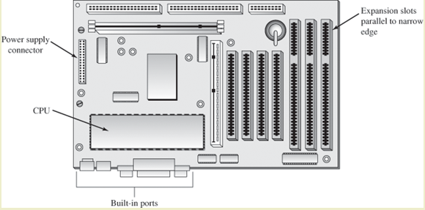
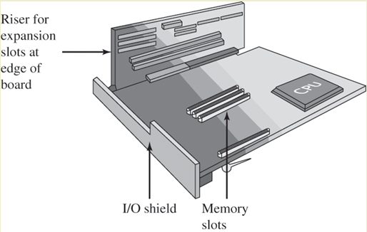
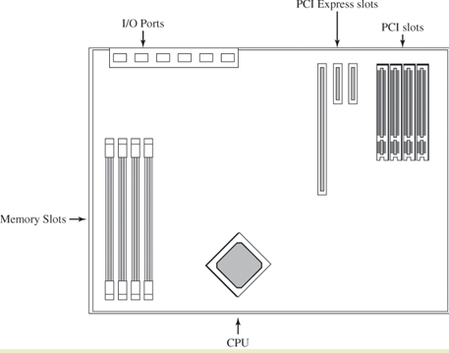
Form factor
The form factor defines the physical size, design and to some extent available functionality on the motherboard.
ATX (12"x9.6")
Expansion grooves on the wide edge
Built-in IO ports on one side
CPU oriented so it can be cooled by the power supply fan
CPU and RAM perpendicular to expansion slots
Additional space for extra cooling
Micro ATX (9.6 "x9.6")
Smaller machines
NLX
Standing expansion.
BTX
Should provide better cooling options than ATX
Three different sizes:
Full (326 x 266 mm)
microBTX (264 x 266 mm)
picoBTX (203 x 266 mm)
ATX
BTX
NLX
Notes:
If you’re overwhelmed by all the features and details above, you’ll be relieved to hear that, when it comes to motherboard size, your options are pretty simple. The vast majority of today’s consumer motherboards come in one of three sizes: ATX, Micro-ATX, and Mini-ITX.

Slide 12
Integrated and Non-Integrated
Many motherboards are integrated and come with CPU, video card including GPU, network card, bus controllers and everything ready built into the card itself.
Typically for e.g. cheap laptops etc..
Non-integrated motherboards.
Fits additions as expansion cards
Disk controllers, video cards, network cards,…
Increasingly unclear distinction nowadays…

Slide 13
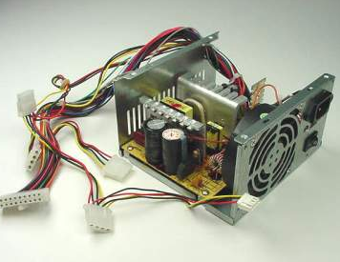
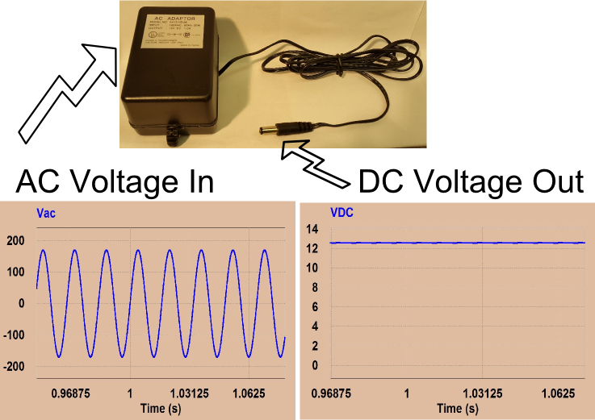
Power supply
Transforms 220 V, 50 Hz AC (AC) to the voltages DC (DC) components of the motherboard need
3,3 V
+/-5 V
+/- 12V
The type of power supply you can use depends on the other things, form factor on the motherboard
Notes:
https://www.fsp-group.com/en/knowledge-tec-26.html#:~:text=In%20a%20nutshell%2C%20an%20AC,DC%20electricity%20supply%20to%20operate.

Slide 14
CPU

Slide 15
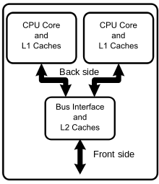
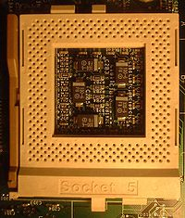
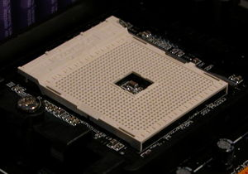
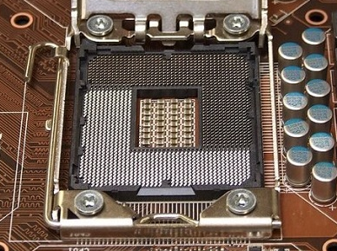
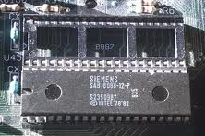
CPU Socket
The CPU is connected to the motherboard through a socket (or in an expansion slot)
Different types with different number of slots for CPU pins
Speed on Front Side Bus (FSB)
Depends on the motherboard
1980
1994
2004
2011

Slide 16
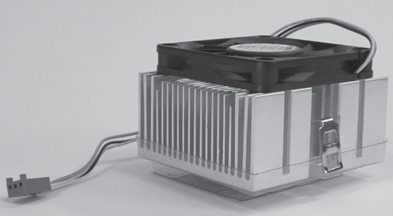
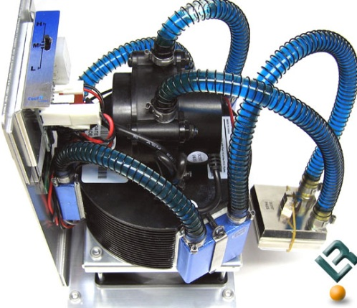
CPU cooling
CPU
Power (W = J / s) is energy per unit time, 1 Watts = 1 Joules per second
manifests itself as heat generation
E = UI, U = RI (Ohm's law), E = RI²
=> The heat rises with the square of the current
Air cooling
Uses fan
Liquid cooling
Pumps away the heat with liquid
Typical water (or liquid nitrogen)
Ohm's law can be expressed as I = U / R where
I = current (ampere, A), U = electrical potential (volts, V),R = resistance (ohms, Ω)
Electrical Power = energy
E=UI=RI²
Notes:
https://www.engineeringtoolbox.com/ohms-law-d_1658.html

Slide 17
Troubleshooting: CPU
Typical problems are cooling or electricity
Symptoms
PC does not boot or load OS
PC crashes with some applications
Sudden POST errors for a lot of different equipment
Heat problems (typical)
PC boots, but stops / freezes / reboots after a few minutes
Mt
itigation: better cooling
error message displayed on the monitor during the power-on self test if the BIOS encounters some kind of problem while starting the PC.

Slide 18
RAM

Slide 19
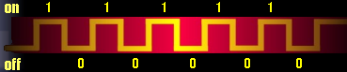
Bit, Byte and Word
BIT
Binary DigIT
On/off
1 or 0
BYTE
8 BIT
Can store e.g. an alphanumeric character
Smallest addressable device in RAM.
WORD
In computer architecture, this has several meanings
The size of a register
The number of BIT the CPU can process as a unit
Addressing unit
Notes:
BYTE, WORD (16), DWORD (32) and QWORD (64) are MicrosoftSpeak - not everyone uses these terms

Slide 20
Types of Memory Problems
Configuration
More memory than PC or OS support
BIOS CMOS error
Hardware
Defective pieces or modules
Incompatible modules.
Installation
the module is not inserted correctly into the slot
Tracks ("socket" defective, or should be cleaned)

Slide 21
Memory troubleshooting
Other components can cause problems that look like memory problems!
Memory problems typically show up:
First booting
Immediately after installing
new RAM module
new software or new OS
After new hardware has been added, or old removed
Completely without any obvious cause
Corrosion ("rust")
Heat damage

Slide 22
Common RAM issues
PC does not boot, POST beep code
Memory inserted, or configured, incorrectly
PC boot to blank screen
Memory module detached
Memory module of the wrong type
POST memory count error
Incorrect RAM module type
"Memory Error" message
Compatibility issues with old and newly installed RAM
RAM module about to break

Slide 23
Peripheral buses & equipment

Slide 24
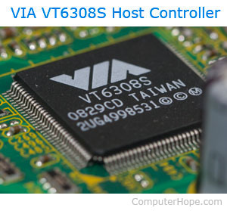
I/O devices
Almost endless selection of I / O
Common concepts
Gate
Bus (daisy chain or shared direct access)
Controller (host adapter)
I/O instructions control devices
The collaboration with the OS usually takes place through a driver that translates the OS instructions into Controller instructions
A host adapter, HBA (host bus adapter), or host controller
allowing communication with devices
some host adapter can be added to a computer, like a PCI card, others are integrated into the computer motherboard (e.g., hard drive host adapter).
Integrated host adapter are commonly referred to as IDE ports or SATA ports on a motherboard.

Slide 25
Addressing devices: Direct, Memory-mapped
Memory-mapped I/O (MMIO) and port-mapped I/O (PMIO) are two complementary methods of performing input/output (I/O) between the central processing unit (CPU) and peripheral devices
Memory-mapped I/O uses the same address space to address both memory and I/O devices.
The CPU instructions used to access the memory can also be used for accessing devices.
Port-mapped I/O often uses a special class of CPU instructions designed specifically for performing I/O, such as the in and out instructions found on microprocessors based on the x86 and x86-64 architectures
Resource conflicts can arise when two different subjects try to use the same Object (resource)

Slide 26
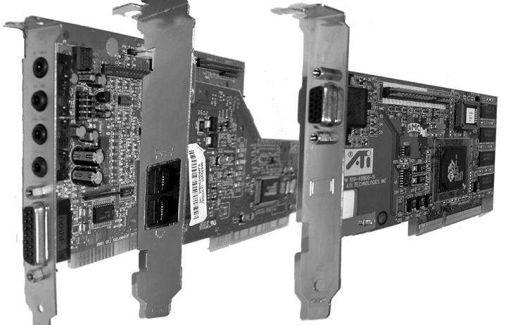
Expansion buses
Let us add new functionality in the form of cards and peripherals
Connected to slots on the motherboard where we mount the expansion card
Different technologies
PCI, AGP, ISA, PCIe
Perform communication between the card controller and the chipset
Expansion card

Slide 27
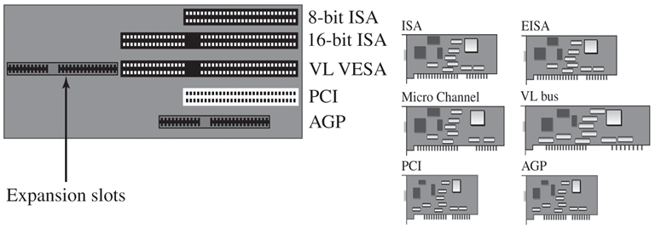
Old expansion cards and slots

Slide 28
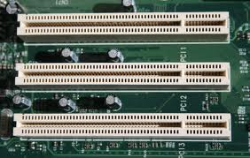
PCI
32 and 64 bit data
Bit rate up to 66 MHz, 533 MB / s (64 bit)
CPU independent
Backcompatible with ISA, EISA
Plug and Play (PnP) support

Slide 29
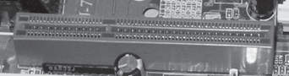
Accelerated Graphics Port (AGP)
Made to support 3D graphics
Connected directly to Northbridge
32 bit, 66 MHz
Bit rate from 266 MBps to 2133 MBps depending on version
Versions 2X, 4X, 8X transmitted data 2x, 4x and 8x per clock cycle

Slide 30
Data Storage (Hard disk)

Slide 31
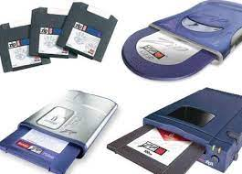
Data Storage
Used for permanent storage of large amounts of data
Punched card
Punch tape
Diskette, Flash Mem
Zip, Jazz
Disk
CD, DVD
Magnetic tape (reel tape, cassette)
Transfer to the processor via a controller
Use different HBA: IDE / EIDE, SATA, Small Computer System Interface (SCSI),…

Slide 32
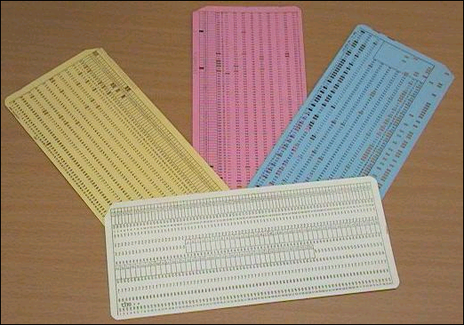
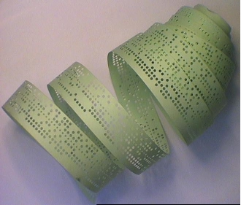
Paper as a storage medium

Slide 33
Files, Organization of data
Data is basically a collection of 0s and 1s which in their context represent a document, image, music etc.
This collection is called a file
A file has a name that makes it easy to identify
In an identification field that is added to the file, in addition to the name, there is also information such as the size of the file, when it was created, the owner of the file, ...............

Slide 34
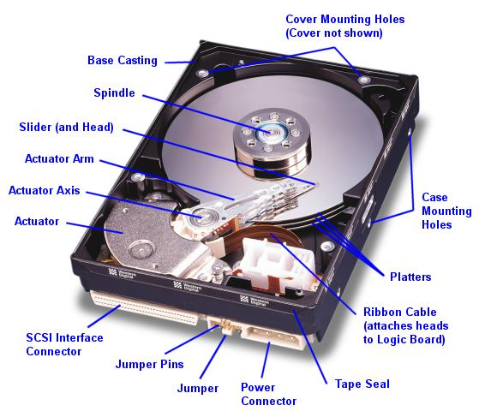
Disk

Slide 35
Disks
Disks ...
Provides lasting storage
is cheaper per byte than RAM (currently)
has greater capacity.
are many orders of magnitude slower.
Important parameters are
storage space
I/O bandwidth
Because...
... there is a colossal speed difference (ms vs ns ~ 106) with RAM.
... disk I/O is very often the most important performance bottleneck.
the speed with which the data transfer takes place between the hard disk drive and RAM

Slide 36
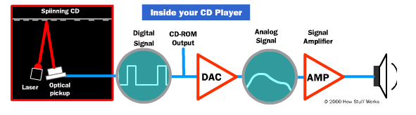
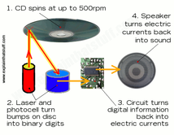
CD/DVD/Blue-Ray (1)
A CD can store 700 MB, DVD 4 GB on each side, Blue-Ray 25GB per layer (up to 8 layers in RW)
https://www.youtube.com/watch?v=H-jxTzFrnpg

Slide 37
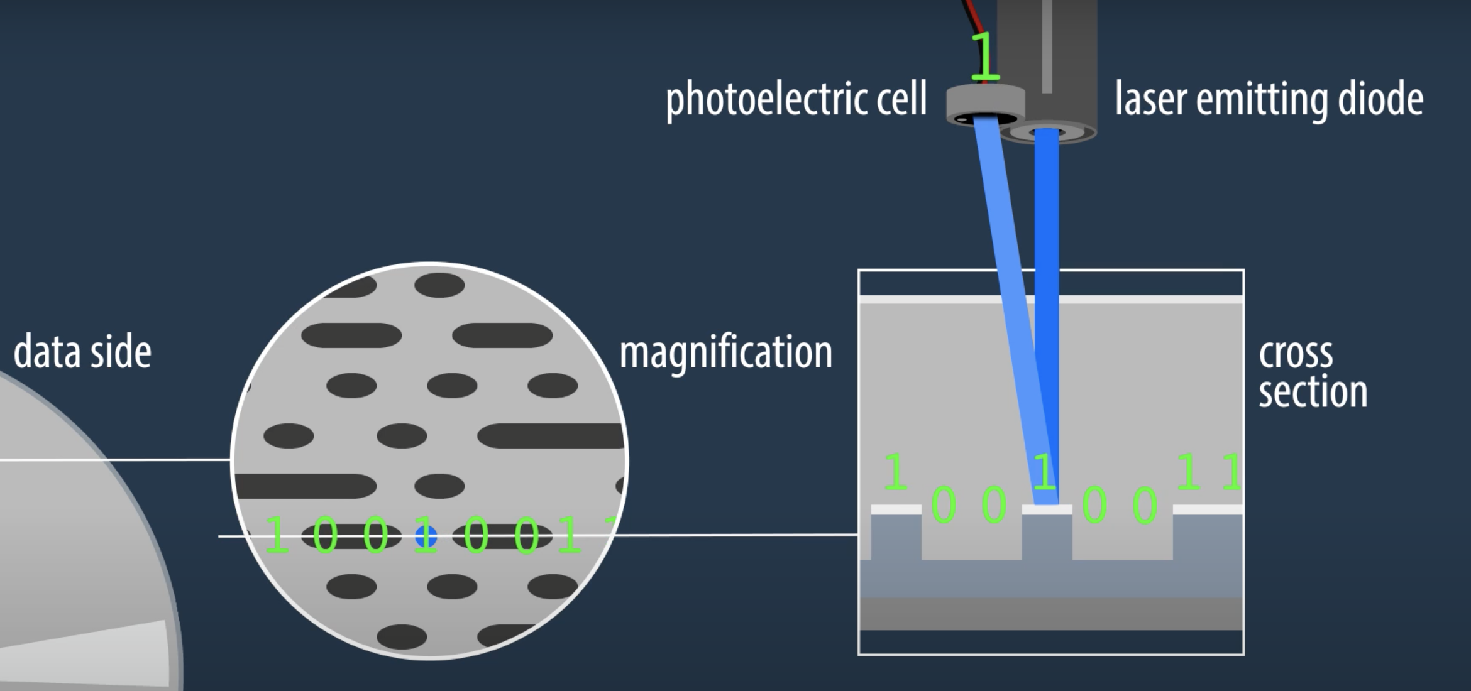
CD/DVD/Blue-Ray (2)
https://www.youtube.com/watch?v=H-jxTzFrnpg
https://www.youtube.com/watch?v=2lzKy8d9BKE

Slide 38
Backup
All types of storage media can break
Important data should therefore be stored in more than one place
It's too late to think about backing up after a crash
Home burning has become more popular lately!
Remember the legal / ethical side of data copying !!

Slide 39
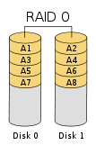
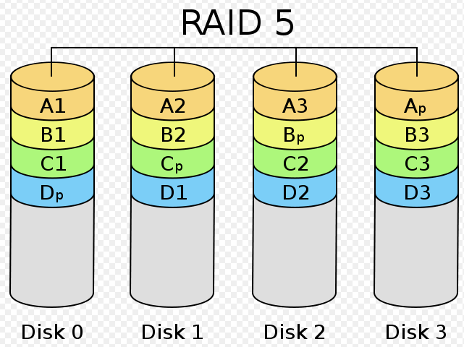
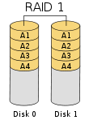
RAID (Some types)
Designation | Technique
RAID 0 | Striping | Faster access
RAID 1 | Mirroring | Faster access, more reliability
RAID 5 | Striping and distributed parity blocks | Faster access and more reliability

Slide 40
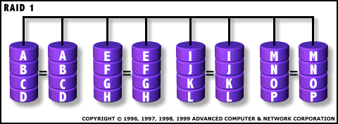
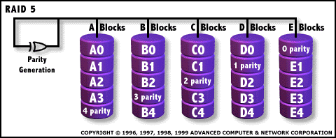
Protection against errors and crashes (RAID)
Large disk banks can leave each disk on its own two feet, RAID0
or generate continuous copy of all disks, RAID1
or use other securing techniques (e.g. striping)
RAID5 creates a checksum (XOR) for two disks and stores this on a third disk. This is good enough if a disk crashes.

Slide 41
Typical Hard Disk Problems
common causes
Fault in controller / adapter
Incorrect pairing of adapter and disk
Errors on the disks themselves
CMOS config error
Resource conflict
Corrupt or missing Boot partition
Virus in boot partition
Defective (mechanical defects)
A boot partition is a volume of the memory that contains the system files used to start the operating system.

Slide 42
Typical error messages (accordingly)
Hard disk configuration error
Incorrect CMOS config parameters
Loose data cable
Hard disk 0 failure
Incorrect CMOS config
Poor connection to power supply.
Hard disk controller failure
Poor cable connection
Poor connection to power supply

Slide 43
USB and Flash memory

Slide 44
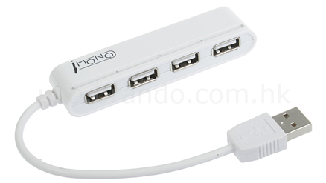
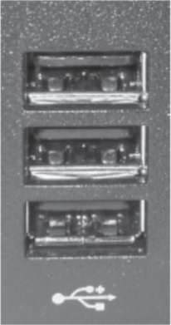
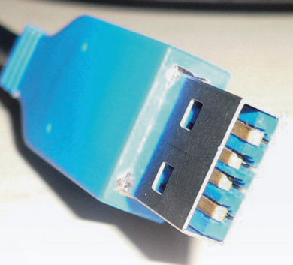
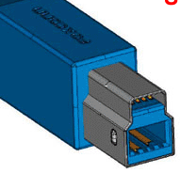
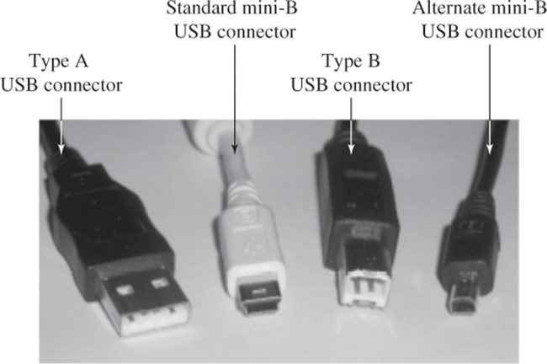
USB – Universal Serial Bus
Supports up to 127 different connected devices
Expands with hub
High speed data transfer.
USB 1.1: 12 Mbps (max)
USB 2.0: 480 Mbps (max)
USB 3.0: 5 Gbps (max)
Variable bitrate
Low speed channel for slow equipment
Four main types of data transfer.
Bulk, interrupt, isochronous, control.
PnP and hotpluggbar.
Can be used for charging

Slide 45
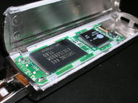
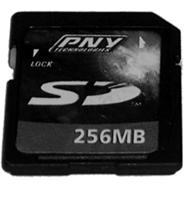
Flash Memory
Two types: "NOR" and "NAND”
NOR (parallel-connected)
Random Access reading / writing
Best for programs
Widely used in mobile phones.
NAND (serial-connected)
Read in blocks (as HD)
Cheaper, more transistors on smaller area
Faster to read from than to write to
Best for data.
You can (on both types) only delete blocks!
Holds to about 100,000 write / delete
512MB -> 256 GB (2009) -> 1 TB
NOR vs. NAND Flash Memory
https://www.youtube.com/watch?v=jAQiMWmSlIo

Slide 46
Peripherals

Slide 47
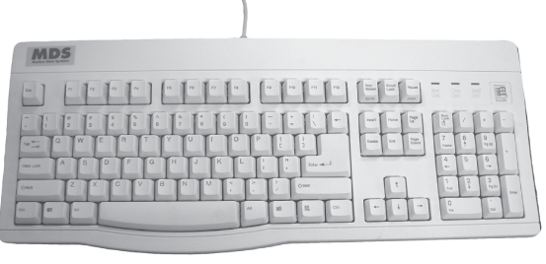
Keyboard
Typically, 104-key IBM PC is standard (qwerty)

Slide 48
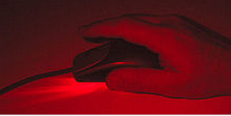
Mouse (optical)
LED or LED laser emits a beam of light
Low resolution «camera» (20x20 px ->) takes «pictures» about every 1/10 second (often more often)
Chip measures / calculates the difference between images and calculates position change

Slide 49
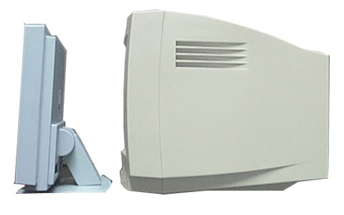
Screen
Two main types
Cathode ray tubes (CRT – Cathode Ray Tube)
Was usually long, almost gone …
Flat-panel
LCD – Liquid Crystal Display
Plasma display, FED, LED, polymer display, OLED
https://www.youtube.com/watch?v=K-kxIP3FhCk
https://www.youtube.com/watch?v=qOsibeDX8jM

Slide 50
What should we know?

Slide 51
What should we be able to do now?
What motherboards and chipsets are
CPU (vs GPU) and why cooling is necessary
RAM: types and roles
Hard disk, addressing, partitioning, parity and RAID
Peripheral equipment, expansion and peripheral buses
The principle behind LCD monitors

Slide 52
Next lecture
Operating system
What is it really for?
How does it relate to everything we've been through so far
What is the difference between the different (Windows, Linux, OSX)
How to work in a shell

Slide 53
For optional self-study
For those who want to learn some topics more in depth to better understand, here are some extra topics related to today's teaching, it must be expected some personal work to understand these topics.
There will be no questions on the exam from these, and this is therefore not considered to be part of the syllabus.

Slide 54
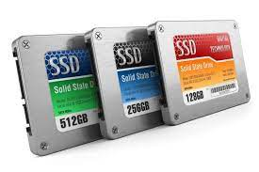
SSD: Solid State Drive
(Most often) the same storage technology as Memory Stick (NAND)
50-100 times faster (shorter access time) than HardDisk
No mechanics, arms that have to be moved, etc.
Limited life, just like Flash Memory.
10-20 times as expensive per GB.
Available up to 4TB (?).

Slide 55
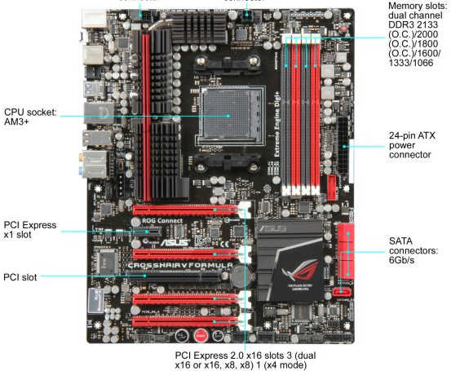
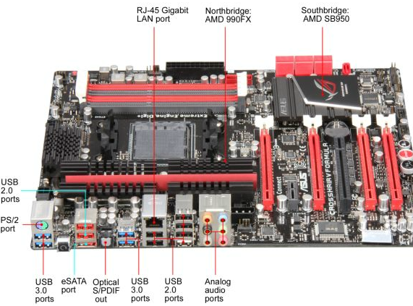
Motherboard about 2011
Kilde: http://goo.gl/ybDrs
Notes:
ASUS Crosshair V Formula AM3+ AMD 990FX SATA 6Gb/s USB 3.0 ATX AMD Gaming Motherboard

Slide 56
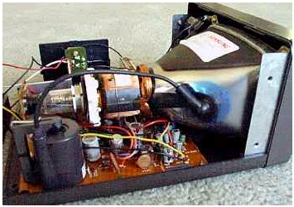

Screen
An image element (pixel) consists of 3 colors (red, green and blue)
All items on the screen were updated several times per second.
The size of the screen is stated as the length of the diagonal.
Controlled by graphics card with memory.

Slide 57


Screen

Slide 58

Video-card
Interprets and controls what is to appear on the screen
Own memory, determines the maximum resolution and color depth
Dot pitch; the distance between two pixels(0,25 mm)

Slide 59
Graphics
There are many standards for on-screen graphics.
Mostly, the standards evolve after the development of screen technology.
Example: SVGA (Super Video Graphics Array)
Resolution : 800*600 → 1600*1200 pixler
Color depth : 256( 8 bit) → ca. 16 millioner (24 bit)
Refreshment rate : 50 → 100 Hz
The number of possible simultaneous colors depends on the size of the video memory.

Slide 60

«Countless »standards (px, colors)

Slide 61


Flat panel (LCD)
Each pixel has an address
Only changed pixels are updated
Very stable image of good quality
Problematic in sunlight

Slide 62

Example: An LCD subpixel
Light from background board
Polarizing filter (vertical)
Liquid crystal that "twists" the polarization when you "turn on power"
Polarizing filter (horizontal)
Colour

Slide 63
So far
Generally
Digital vs analog, def computer
Data types
Tall, text, images, sound
CPU
Structure
Register
Instructions

Slide 64
Addressing binary
1111111
0000111
0000101
0000011
0000001
Binærgaten
1111110
0000110
0000100
0000010
0000000
With 7 binary digits (bits), 27 = 127 + 1 = 128 = «house» can be addressed.
At each address "lives" a byte.

Slide 65
System resources
The buses use one or more types of system resources
I / O port addresses
IRQ= Interrupt Request
DMA channels=Direct Memory Access (DMA)
Resource conflicts can arise when two different subjects try to use the same Object (resource)
Plug-and-Play (PnP): Configuration standard that automatically allocates system resources to expansion cards and equipment

Slide 66

Magnetic storage / reading
Storage
When the electromagnet is supplied with power, the surface under the magnet is magnetized.
Reading
When the surface under the magnet is magnetized and passes the magnet, power will be generated (induced).
Magnetized area = 1
Not magnetized = 0

Slide 67



Magnetic tape

Slide 68

RAM for PC
Addresses
16 bit = 65536 = 64 KiB
20 bit = 1MiB
32 bit = 4 GiB
64 bit = 16 EiB
DRAM - Dynamic RAM
Must be refreshed; read / rewrite.
SDRAM - Synchronous DRAM
In step with the CPU.
SRAM - Static RAM
Does NOT need to be refreshed, faster a DRAM, but more expensive to produce and needs more transistors per bit stored

Slide 69



Physical organization
DIP (Dual In-line Pin) right on the motherboard.
SIMM (Single In-line Memory Module)
Snapped on the motherboard
DRAM; 60 to 120 ns
SRAM and cache; 20 ns
Odd Parity
10010110 1
Used to check if errors have occurred.
DIMM (Dual In-line Memory Module)
Contact points on both sides
64 bit bus connection.
168, 184, eller 240 bus connections.
RDRAM is a variant
There are many variants in terms of number of connection points, type of bus etc.

Slide 70

DRAM form factors (some)

Slide 71
DRAM technologies
Previously
Asynchronously, the system clock did not follow
FPM, EDO, etc..
Current
Single Data Rate RAM
One read / write per clock / bus pulse
Double Data Rate RAM (DDR, DDR2, DDR3)
RAMBUS
RAM performance depends more on the package and bus, than on the RAM itself.

Slide 72
DRAM characteristics
CAS (Column Adress Strobe) latency
Number of clock cycles it takes to move requested data to the legs of the RAM module
For example. CL2 (two clock cycles)
Dual or quad channel
Motherboard-dependent - number of parallel RAM channels.
Single vs double row
Double-ranked has two separate groups of RAM chips that are accessed separately by the RAM controller.

Slide 73

Win7: devmgmt.msc
In win7 / 8/10 you can inspect which resources in MMC snapin devmgmt.msc

Slide 74
Data buses

Slide 75

Motherboard: Buses
Serial vs parallel
Data / Address / Control / Power
Width (#bit), tempo (Hz)
Two main buses:
System / FSB
connects CPU to Northbridge / RAM
Expansion
Connects the chip to expansion slots

Slide 76
Chipset
The controllers that control the exchange of data / instructions / interrupt signals between the CPU and other equipment are often referred to as the motherboard chipset
In the last ten years, these have typically been two main controllers
Northbridge (Intel: Memory Controller Hub)
CPU and memory (RAM)
High speed equipment: graphics card
Communication with Southbridge.
Southbridge (Intel: IOController Hub)
Peripherals (typically outside the cabinet)
Minor controls
Secondary and old-fashioned buses

Slide 77



The transport system
"Cables" with parallel and serial "wires"
Width * Speed = Bandwidth

Slide 78
The tasks of the buses
Addressing of data
Shipping of data
Synchronization of machine components
Flow control between the components
Signaling between the components
Power supply for some components

Slide 79
Addressing
Width from 20 to 64 bits
32 bit allows to address (2³²=) 4 GB
There are techniques of sending multiple bits / bytes at a time.
Needs less width on the bus
Needs more control in the components

Slide 80

Synchronization
Internally in the machine there will be several clocks
CMOS (BIOS) has a "regular" (real-time) clock
All other clocks are actually clockmakers.
Synchronous components
Keeps the same or similar pace
Asynchronous components
Each keeps his own pace

Slide 81
Interrupt signals
Interruption signal is a message that something has happened.
It's the mechanism that lets the CPU and controllers know that something / someone wants something done.
IRQ - Interrupt Request
Such signals can be given different priority
Own components for registration and further processing

Slide 82



Interrupt (and Exception) Handling
The IA-32 architecture has an IDT with pointers to 256 different interrupts and exceptions
32 (0 - 31) predefined and reserved
224 (32 - 255) user / OS defined.
Each interrupt has a pointer in the Interrupt table (IDT) and a unique index value that provides handling as follows:
Process runs when the interrupt occurs
Save state, context switch and find the correct interrupt handler
Execute interrupt trades
Recover (interrupted) process
Continue execution
user
kernel
disk interrupt (x)
IDT:
Interrupt routines:

Slide 83

Storage development (1)

Slide 84

Storage capacity (2)

Slide 85

Density and price (3)

Slide 86


The structure of the disk
All arms move at the same time
Each arm has 2 heads
In / out 50 times / sec
Spin: 3600-7200 (15000) RPM
Search time: 10-20 ms
Data rate: 5-40 MB / sec ~ 300Mbps w / SATA)

Slide 87


Reading heads
The reading heads float on the air above the plate (0.001 mm)

Slide 88



Disk organization
Track
The area the reading head covers on a rotation.
Sector
The smallest part of a track that can be read
Cylinder
All tracks in the same position on the disc
512 bytes per sector * 51 sectors per track * 723 cylinders * 14 read heads = 264305664 B = 252 MB

Slide 89
Disk Access Time
Will have
block X
block X
in memory
Disk plate
Disk access time =
Disk head
Search time
+ Rotation delay
+ Transfer time
Disk arm
+ Other delays

Slide 90
H-Disk addressing of sectors
Previously (and due to backward compatibility) CHS (Cylinder, Head, Sector) or Extended CHS was used.
Originally limited to 1024 C, 16 H, 63 S = 528 MB
BIOS Interrupt 0x13 extended to 8G at 0-254 Head
24 bit address, 512 B sector = 8G hard drive
Now used LBA (Logical Block Adressing)
Originally for SCSI, then for ATA / SATA
The sectors have logical linear LBA addresses 0,1,2,3…
C 0, H 0, S1 = LBA 0, …
32 bit addresses give max size 2TB
LBA is supported by all modern OS and BIOS
In the future, GUID seems to take over
Supported by UEFI
64 bit addresses
allows in principle disks up to 8 ZiB (assuming 512 Byte blocks)

Slide 91

The logical organization of the disk (hierarchy)
Cluster
Minimum unit read by the operating system, minimum 1 sector.
File
Minimum device referenced by the operating system, minimum 1 cluster.
Catalog
File for organizing files
Partition.
Organization of directories; e.g. C :

Slide 92

Low-level formatting
Low level formatting is done by the manufacturer
Addresses are written on each sector
The disk is initialized with zero values
Defective areas are marked
The interleave pattern is set
The example shows 3: 1 interleave

Slide 93
Partitioning
Partitioning is done by supplier (or user)
Made from «DOS» with the program FDISK
Creates MBR (Master Boot Record) at the start of the disk
Used by the BIOS to boot the operating system
Minimum 1 partition (primary)
Can add secondary (extended) partitions
Cannot have two operating systems in the same partition (other than as Virtual Machine)

Slide 94
High-level formatting
High-level formatting is done by the supplier (or user)
Can be done from DOS with the program FORMAT
Receives warning from operating system if it is primary partition
Adds content from MBR into the startup sector
Not all disks can be booted
Stock root directory
Defines how many sectors there are in a cluster
Builds file allocation tables (FAT)
FAT12, FAT16, FAT32, (NTFS, Ext3)

Slide 95
Fragmentation
Start
Fil#1
Fil#2
Fil#3
Fil#1
Edit
Fil#1
Fil#3
Fil#1
Delete
Fil#1
Fil#3
Defrag

Slide 96

Parity bit
In order to be able to identify "bad blocks" (sectors with errors), each sector has a parity byte that is used to check whether errors have occurred.
Parity check was part of 7bit ASCII:

Slide 97

Parity bit
1 parity bit can only detect odd number errors!
Uses CRC checksums that provide the opportunity to detect far more errors (more in the penultimate lecture)
Parity can be easily generated with XOR!
Using smart coding, you can create better checksums. (cf. social security number)
parity?

Slide 98

Error Correcting Codes (ECC)
Based on the Hamming distance between the codes
Example
In this code set, there is always at least three bits difference between all the codes The hammering distance between A and B is 4, B and C 3, etc.

Slide 99

ECC (2)
Reading 010100, which letter should it (probably) have been?
The one with the least Hamming distance in the code set.
With Hamming-distance 3 in the code set, you can detect up to two error codings (bit-flips) and correct one.
With Hamming distance 5 in the code set, you will be able to detect up to four errors per pattern and correct two

Slide 100



Buses / sections: ATA, SATA
(Parallell) ATA
(Parallel) ATA
Versions 1-7
Original IDE
Supported LBA and DMA
Cable with 80 parallel conductors
Max 133 MBps.
SATA: Serial
Latest version supports up to 6 Gbps (v. 3.0)
Cables up to 8 m
eSATA for external connection
HotPlug!

Slide 101

SCSI
Allows series connection of equipment.
Each must have their own ID.
Most used on servers
Versions 1-3
A collection of different standards!
iSCSI is e.g. a combination of Etrhernet and SCSI

Slide 102
Device controllers
I / O devices often consist of
Mechanical component ("the device itself")
Electronic component
The electronic component is the device controller.
"A small microprocessor"
Can possibly handle several units
The tasks of the controller
Receive instructions
View status
Convert serial bitstream to block of bytes
Perform error correction as needed
Make data available in primary memory (RAM)

Slide 103
I / O ports and addresses
Each controller has some registers that are used to store status and communicate with the CPU
Can write to these to control the device
Can read others to find the condition of the device.
May also have data buffer
Video RAM on video card
Cache ON disk
Can write registers / buffer using I / O ports
Can also use the memory mapped I / O

Slide 104
Ex: read from disk
application
Pentium 4
Processor
file system
registers
cache(s)
disk
system bus
(64-bit, 400/533 MHz →~24-32 Gbps)
RDRAM
memory
controller
hub
RAM interface
(two 64-bit, 200 MHz → ~24 Gbps)
RDRAM
RDRAM
RDRAM
hub interface
(four 8-bit, 66 MHz → 2 Gbps)
I/O
controller
hub
PCI slots
PCI bus
(32-bit, 33 MHz → 1 Gbps)
PCI slots
PCI slots
disk

Slide 105

PCIe
High speed serial bus architecture
Supports multiple channels
Different tracks avh channel number
Structure
Point-to-point
Packet-based and routed a la network
Addresses and data are in the same package
High bit rate
Each channel supports duplex, 2.5 Gbps each way
SUPPORT FOR SEVERAL GRAPHIC CARDS
Why single direction?

Slide 106
Start-up

Slide 107
BIOS – BASIC I/O SYSTEM
Software for controlling essential components
For example. Keyboard, screen, disks, serial ports, …
Stored on ROM chip
Three main functions
Boot PCs
Test and verify hardware
Provide interfaces between hardware and software.

Slide 108

Boot -the sequence
.The power supply starts up
The primary part of the BIOS is loaded into RAM
The CPU reads the start address of the BIOS boot program.
Boot type confirmed.
Cold boot: turns on
Warm boot: restart / rest, does not run POST
When PC restarted or reset, does not run POST.
Power On Self Test (POST) begins.
Error messages are given as "beep codes"
Video adapter software loads.
The BIOS for other equipment is loaded
BIOS startup screen loads
Error messages are displayed as text..
CMOS configuration tested.
Checks that equipment listed in CMOS is present and working.
Ports assigned and equipment configured.
Hardware configuration confirmed
BIOS displays summary screen
Operating system located and loaded (MBR).
Boot fails:
When the PC fails to complete the BIOS and load the OS
Typical causes are loose or missing components, and / or OS / driver errors on disk.

Slide 109
Power On Self Test (POST)
Error codes are (mainly) dependent on the BIOS manufacturer
Two types:
Beep codes
Long and short tones in speaker
Error messages
To screen
1xx Motherboard, 2xx RAM, 3xx Keyboard, 17xx HD,…
3-4 digits with some explanation
«BIOS ROM checksum Error: System halted»
Hard disk install failure »
Memory Test Fail.
Easy BEEP in speaker when POST performed
109

Slide 110
CMOS
BIOS setup program: Used to configure settings stored in CMOS.
CMOS settings ≈ Hardware configuration
SETUP:
Typically has menus to set:
Default Settings
Boot medium order
System date and time
Hard disk, floppy, ..
Video display
Advanced settings: Motherboard, CPU, chipset
Plug and Play (PnP) options, power management, security and passwords, integrated controllers for peripherals.

Slide 111
BIOS update
The BIOS "determines" what kind of equipment the PC may have connected
Upgrading ("flashing") of the BIOS is occasionally needed to solve special problems
You can corrupt the BIOS chip by interrupting during updating, or trying to enter the wrong BIOS
Now replaced by different types of firmware
111

Slide 112
BIOS->UEFI
BIOS is for 16 bit machines…
Supports only 1 MiB of memory.
Is in the process of being replaced with Unified Extensible Firmware Interface (UEFI)
Supports both 32 and 64 bit instructions from startup
Supports a minimum of 2GB of memory
Supports a new addressing method for partitions and blocks on the Hard Disk (GPT instead of MBR) which allows hard disks larger than 2 TB to be used -> 8 * 2 ^ 70
112

